Slide 1

Notes:
Do you have cows that never seem to get sick? Invisible cows that you don’t notice because they’re never in the sick pen. What distinguishes these cows? They are exposed to the same environmental conditions as other cows, but they appear to have a natural resistance or defense to fight infection and pathogens. What they have is a higher immune response. Semex is very proud to be offering an innovate new product line, exclusive to Semex, of high merit sires who possess a high immune response to fight both viral and bacterial diseases, and they pass on this boost of higher immunity to their daughters. Immunity+ sires provide a greater resistance to disease.

Slide 2

All Dairy Producers Want
More Healthy Cows
The Problem
Difficult to improve genetically – low heritability
Poor data quality & inconsistency in disease diagnosis
Selection to fight one disease may be counter-productive to other diseases
Notes:
It is unanimous among all dairy producers. Everyone would love to have more healthy cows. The modern dairy cow of today must prevail under higher demands and greater strain and the continued exposure to pathogens makes them more susceptible to disease. Unfortunately, with the health traits of today, it is very difficult to improve the disease resistance of cows genetically. Low heritability and the lack of quality disease data are among the many limitations.

Slide 3
Increasing Incidence of Disease
%
NAHMS Dairy 2007 Part II: Changes in the Dairy Cattle Industry 1991-2007
Notes:
The result has been an increasing trend in the incidence of most common diseases which inflict the dairy cow. Advancements have been made in treatment and care, however it has not been able to reduce the number of sick cows or the cost of poor health on the dairy.

Slide 4

Notes:
Maintaining a healthy herd of cows is a high cost item on the dairy. Added vet costs and treatments, added labour costs, delayed conceptions, reduced production, discarded milk from treated cows, more culls and deaths, higher replacement costs and reduced efficiency. These added costs go directly to the bottom-line.

Slide 5
What if…
What if there was a way to genetically enhance disease resistance through improved overall immune response
We could actually reduce the incidence of disease with each generation
Notes:
What if there was a way to build overall disease resistance genetically. What if we could turnaround the negative trends and actually reduce the incidence of disease with each passing generation. What if we could build the cow’s natural immune system to defend against most types of disease and infection.

Slide 6
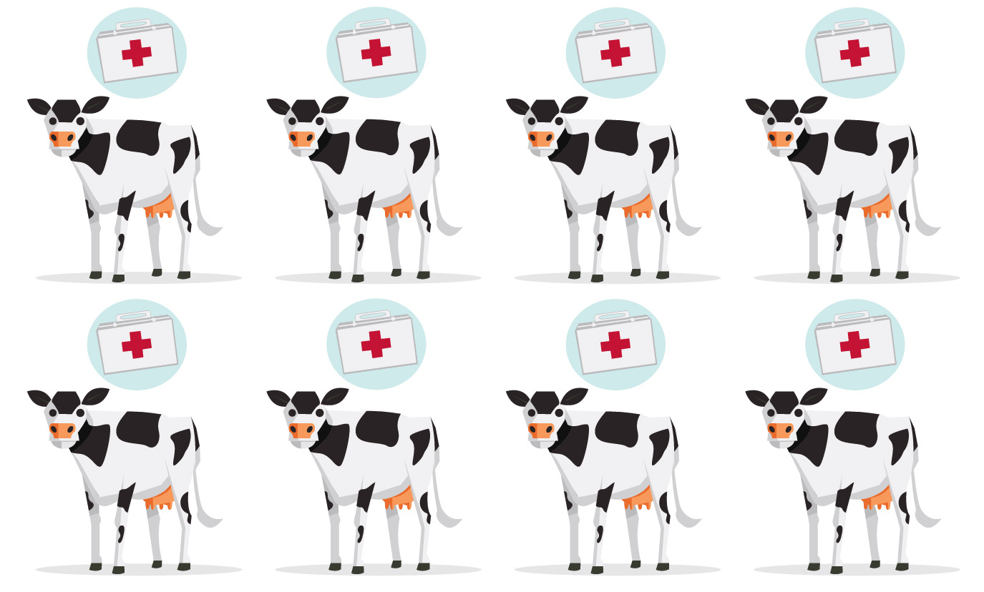
Notes:
What if there were fewer cows in the sick pen, fewer cows to treat, fewer cows whose performance is negatively affected by reduced health.

Slide 7



Notes:
Well there is a way. Improve the genetics for immunity in your herd by using Immunity+ sires. They offer disease resistant genetics for greater health and profit of your dairy.

Slide 8
Immunity+ Sires
Bulls tested for immune response
Transfer high immunity to their daughters
Daughters have lower incidence of mastitis, metritis, retained placenta, Johne’s & other diseases
Notes:
A large number of proven and genomic Semex bulls have been phenotypically tested for immune response. The highest bulls for immune response have been identified as Immunity+ sires. They transfer their high immunity on to their daughters, which provides their daughters with a greater inherent resistance to common diseases such as mastitis, metritis, retained placenta and Johne’s.

Slide 9
High Immune Response
Semex has exclusive rights to test bulls using “High Immune Response Technology”
Professor Bonnie A. Mallard (PhD)
  Department of Pathobiology
  Ontario Veterinary College
  University of Guelph
Notes:
Semex has invested for over 15 years in the leading edge research on the High Immune Response Technology which has been led by Dr. Bonnie Mallard, a Professor of Immunology in the Department of Pathobiology at the University of Guelph. Semex has negotiated exclusive world-wide rights to test males for high immune response which allows us to offer this outstanding, innovative line-up of Immunity+ sires to Semex customers around the globe.

Slide 10

What Does
Immunity Mean?
Notes:
What is Immunity? It is the body’s natural defense system to fight foreign pathogens and infection. Some individuals have a more optimal immune system, and there are times in one’s life where the immune system can be weakened. So, immunity is about the strength of response to harmful pathogens and infection, and when the immune response is effective, it eliminates or reduces the negative impact that disease exposure can cause. It goes without saying, that a healthy cow must have a strong immune system.

Slide 11
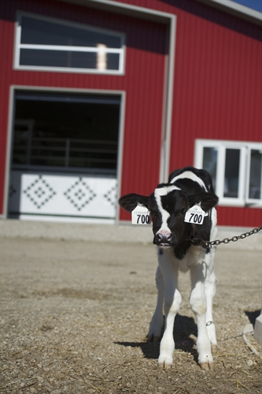
Immunity Types
Passive Immunity
Innate Immunity
Acquired Immunity
Notes:
For review, there are 3 types of immunity that are important a healthy animal. Passive immunity, Innate immunity and Acquired (also known as Adaptive) immunity.

Slide 12
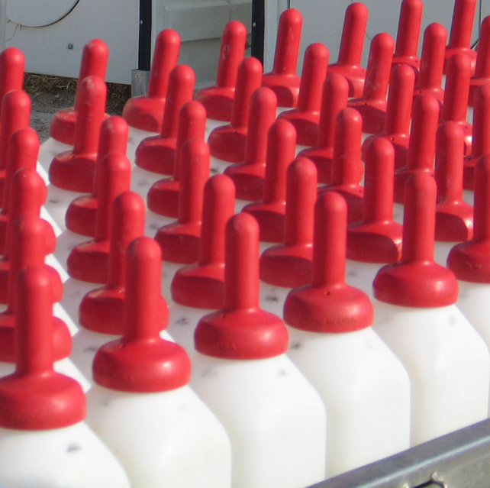
Passive Immunity
Initial and temporary
Passed through colostrum
Contains protective features from the dam
Fades as own immune system matures
Notes:
Passive immunity is the immunity a calf receives when fed colostrum early in their life. It is very beneficial in that it provides immune protection to newborn calves whose immune system has not yet developed. In passing from the dam, it provides protective features from the same environment that calf is entering. However, this type of immunity is initial and temporary. It fades as the calf’s own immune system matures. The benefits are not long-lasting.

Slide 13
Innate Immunity
Innate Immunity
Core of immune system – First line of defense against harmful disease
Non-specific responses
No memory of past exposure
Notes:
Innate immunity is the foundation or core of the immune system. It is received genetically. It is the first line of defense against harmful disease. Innate immunity responds to a foreign pathogen or infection, but has no specific response to it or past memory of a past exposure. The Innate system is also important because it manages the overall response to disease. It directs the acquired (or adaptive) immune system to respond to the presence of a bacterial or viral infection.

Slide 14
Two Types of Acquired Immunity
Fights intracellular infections
ex. Virus or mycobacterium that causes Johne’s
Fights extracellular infections
ex. Bacteria (mastitis)
Cell Mediated
Antibody Mediated
Notes:
Acquired (or Adaptive) immunity is cued by the Innate immune system, which works intrinsically together. An important thing to remember is that acquired immunity and innate immunity are so intertwined that genetic selection for greater acquired immunity will inherently select for greater innate immune responses, particularly those that regulate initiation and activation events .
Acquired immunity is immunity that is developed over an animals’ life as she becomes exposed to different types of viral and bacterial infections and diseases. The acquired immune system has memory of past exposures and recognizes a pathogen if it has seen it before, and then automatically knows the solution to try to fight that disease presence. With each subsequent exposure, the immune response becomes refined and more proficient.
There are two types of acquired immunity. Cell-mediated immunity fights intracellular infections (those which are inside the cells). This is important for fighting viruses and mycobacterium that causes Johne’s. The other type of acquired immunity is called Antibody-mediated immunity. This type of immune response fights extracellular infections which are those infections outside the cells. Antibody-mediated immunity is important for fighting bacterial based infections such as those pathogens that cause mastitis.

Slide 15
Overall Immune Response
Disease
Balanced defense against all diseases
– both viral & bacterial
Immune Response
Immune Response Genes
Notes:
Cell mediated immune response and antibody mediated response have a moderate negative correlation, which means that selection for one of them could result in hindrance to the other type of acquired immunity. Therefore, a balance defense against all diseases involves selection for both cell-mediated and antibody mediated immune response, and by doing so, it will provide general overall resistance to both viral and bacterial diseases. The overall immune response is controlled and directed by over 2,000 genes.

Slide 16
Selection for Immune Response
Measuring strength & effectiveness of the overall immune response
  Provides balanced attack between viral & bacterial infections
  Strengthens both first & subsequent exposures to pathogens
  Feasibility of selective breeding due to high heritability
Notes:
Overall immune response is a measure of the strength and effectiveness of both cell-mediated and antibody-mediated immune response. This results in a balanced attack to fight both viral and bacterial infections. Selection for overall immune response will strength both the first and subsequent exposures to pathogens. A more proficient and robust immune system. The important part about selection for immune response is that both cell-mediated and antibody-mediated immune responses are highly heritable. If immune response had a lower heritability like is seen for productive life, fertility or disease resistance, then there would be little consideration given to it. However, a high heritability for immune response offers a tremendous opportunity to actually make improvement in the animals’ ability to fight disease.

Slide 17
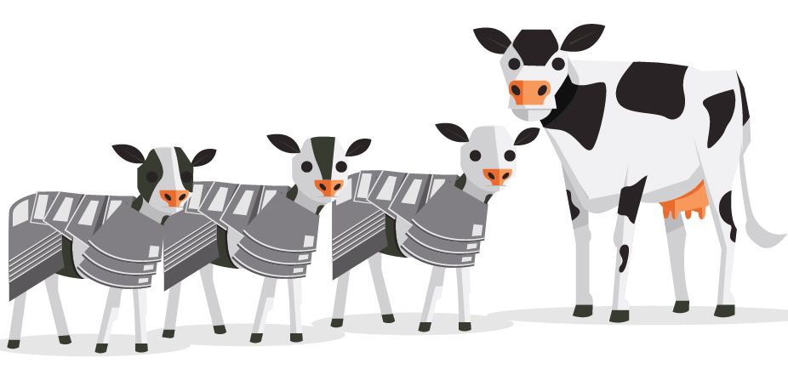
What is Heritability?
Notes:
As a review, what is heritability? From our own lives, we know if a characteristic is heritable, it is a characteristic that we have a good chance of inheriting genetically from one or both of our parents.

Slide 18
Heritability
Definition
Proportion of variation observed in a trait which is due to genetics
  Genetics vs. Management, feeding, housing & environment
Notes:
If we were to assess the differences between all animals for a given trait, then heritability is the percentage of the amount of difference that can be attributed or explained by genetics. An animals’ phenotype (or her actual ability) is explained by her genetics and her environment (management, feed, housing, care, weather, etc.). Heritability is the percentage which is due to genetics. A trait with a higher heritability has a greater chance of being transmitted to the next generation. Greater genetic progress can be made for traits with higher heritability such as production trait and many conformation traits.

Slide 19
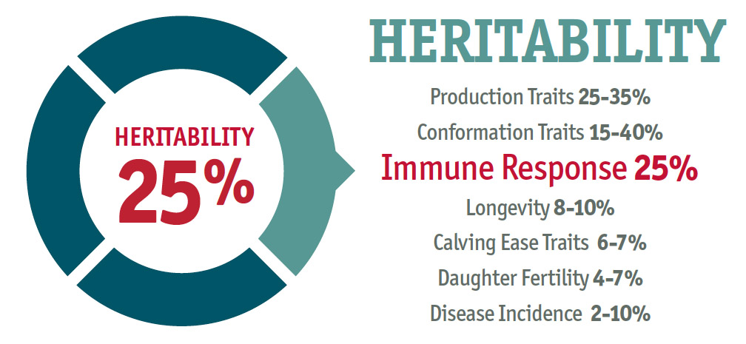
Immune Response
Notes:
Research conducted at the University of Guelph has showed that immune response has a heritability of 25%, which is quite high. Traits that are easily and consistently measured are the traits we see with higher heritabilities. <click> We see this when we look at heritability for other traits in the dairy industry. Production traits that are easily measured are 25-35% heritable. Most conformation traits are highly heritable. Measurable traits such as stature, pin width, udder depth are highly heritable whereas more subjective traits that are difficult to assess such as heel depth have lower heritability. Traditional health traits such as longevity, calving ease, daughter fertility and disease incidence have heritabilities that are less than 10% and extremely low for most disease incidence traits. This is why Immune Response with a 25% heritability offers such a great opportunity to make improvement in the overall health of your dairy cows.

Slide 20
Testing For High
Immune Response
Notes:
We would like to take a moment to explain the process applied to test bulls (or females) for their cell-mediated and antibody-mediated immune responses.

Slide 21
15 Day Process
HIR Test Protocol
HIR test is a 15 day test that requires 3 farm visits:
DAY 1
Antibody: Collect initial blood for ELISA
Antibody: Immunize intramuscularly with type 1 & 2 antigens
DAY 14
Cell: Take initial skin-fold measurement & surface injection
Antibody: Collect final blood for ELISA
DAY 15
Cell: Take final skin-fold measurement 24-48 hours
Notes:
It is not a simple test. It involves multiple technicians testing animals on 3 separate site visits over a 15-day period of time.
On day 1, a starting antibody level is established by collecting an initial blood sample for an ELISA test. After which time, the animal is immunized with an antigen. On day 14, the technicians return collect a final blood sample for ELISA to assess the antibody immune response to the antigen introduced 13 days earlier. Also on the day 14 visit, they take an initial skin-fold measurement under the tail head at a pre-defined location as a starting point for the cell-mediated test. At that same location on the skin-fold under the tail head, the animal is given a surface injection of an antigen. The technician returns on day 15 to take a final skin-fold measurement at that same location on the skin-fold under the tail head to assess the cell-mediate immune response to the surface injection.

Slide 22
Exclusive Product At Semex
Notes:
The result is this new innovative product line, called Immunity+, which is being offered exclusively by Semex to help dairy producers around the world develop their cows’ natural abilities to fight disease and infection.

Slide 23
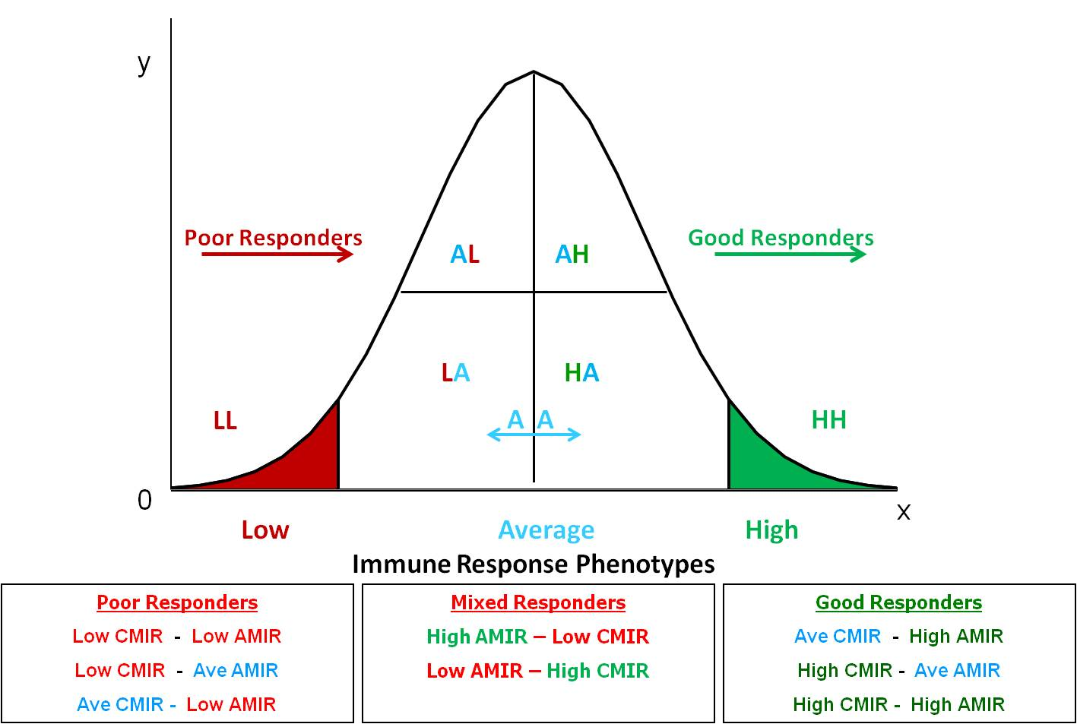
Bulls Designated as Immunity+
Approximately 10% of sires
Immunity+ Sires
Notes:
Bulls that were tested will range from low to high. Bulls could be low-low for cell and antibody mediated immune response, low-average, average-low, high-average, average-high, and finally high-high. It is the high-high category where we want Immunity+ sires to reside. The top 10% according to overall immune response are designated by the University of Guelph as Immunity+ sires.

Slide 24
Immunity+ Sires
General improvement in overall immunity across the herd
  More high immune response daughters
  Daughters will pass on the higher immune response
Just like High Immune Response Cows
  Less disease
  Better immune response to vaccines
  Better immune quality colostrum
  Longer herd life
Notes:
Immunity+ sires will provide general overall improvement in immunity. Not all daughters of Immunity+ sires will have high immune response, however Immunity+ sires will provide a boost of immunity such that the daughters will possess incrementally more immune response than their dams and average herdmates. As such, Immunity+ sires will have more daughters that have high immunity and less daughters that have low immunity. That incremental boost in immunity that Immunity+ sires provide to their offspring will lead to less disease, better response to vaccines, better colostrum and longer-living cows.

Slide 25
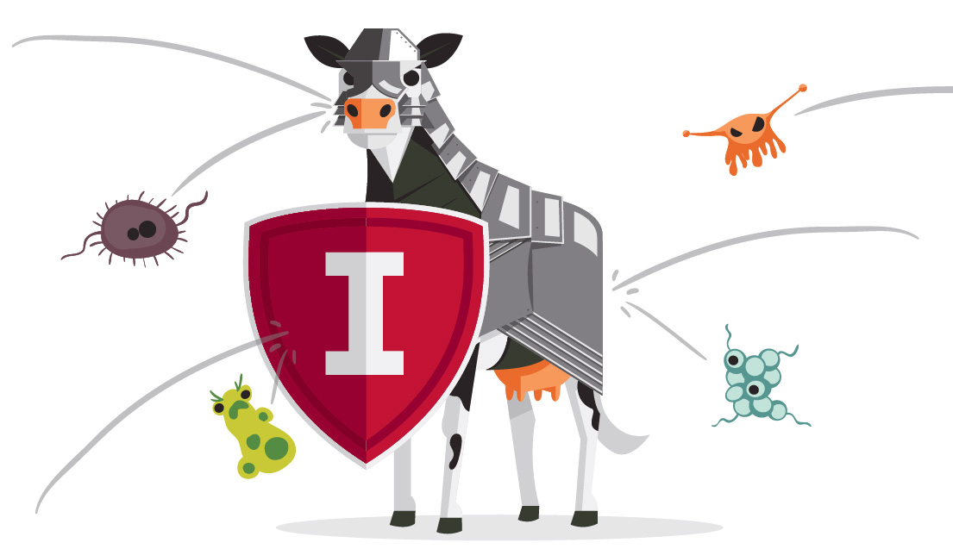
What’s The Significance of High Immune Response?
Notes:
What’s the significance of high immune response?
To answer that question, we will first look at cows that were tested themselves and then were discovered to be high immune response cows. From the research conducted over the past decade at the University of Guelph at Dr. Mallard’s lab, we will summarize the overall benefits of high immune response cows compared to herd average cows. After we assess the benefit in high immune cows, we will then try to estimate what a bull tested as having high immune response (an Immunity+ sire) will transmit in overall benefit to his daughters. As said before, Immunity+ sires will transmit an incremental boost of immunity to their progeny. Not all of their progeny will be high immune responders, however they should have improved immunity over their dams and their average herd mates.

Slide 26
High Immune Cows
High Immune Cows vs. Herd
27% less Mastitis
17% less Metritis
32% less Retained Placenta
700 cows in 3,000 Cow Dairy in North Florida
Range in all herds was 19–30% less incidence of disease (High vs. Herd)
Notes:
High immune response cows have less incidence of disease compared to their herd mates. In a study conducted in a large herd in North Florida, it showed that high immune response cows had 27% less incidence of Mastitis, 17% less incidence of Metritis and 32% less incidence of Retained Placenta. In the 64 herds analyzed in the immune response research, all herds ranged between 19 to 30% less incidence of disease when comparing high immune responders compared to the herd average.

Slide 27
Average Incidence (combined diseases)
Immune Response vs Disease Incidence
n= 64 herds
Disease data from: Wagter et al. 2000 JDS 83:488 and De Lapaz, J. 2008 MSc Thesis, University of Florida.
Thompson-Crispi, K. et al., 2011 Technical Report to the Genetic Evaluation Board, Canadian Dairy Network
Notes:
Some diseases will have a lower incidence like 4% and other diseases may have an incidence of upwards to 30% or more. This graph shows the average incidence of disease averaged over the various diseases. High immune cows (green) compared to average immune cows (blue) compared to low immune cows (red). This research is based on infectious and metabolic combined health data from 64 herds in North America. The graph shows that high immune cows have 2x less disease occurrence than low immune cows.

Slide 28
High Immune Cows
Better Response to Commercial Vaccines
Respond better to commercial vaccines
Lumens OF SERUM ANTIBODY TO J5 E. coli VACCINE
ELISA OD
Reference: Wagter & Mallard et al 2000 JDS 83:488
Notes:
Some dairy producers may indicate they don’t need to breed for immunity because they will manage their health program through vaccinations and management. However, most producers don’t realize the research has shown that up to 20% of animals have no or little response to commercial vaccines thereby reducing the overall benefit of a vaccination program across a herd.
Research conducted at the University of Guelph show that cows tested as having higher immune response also respond better to commercial vaccines. This can be observed in the graph showing the advantage of high immune responders in serum antibody (green line) compared to average and low immune responders (blue and red line respectively). By genetically increasing the immune response in your dairy, you will also improve the proficiency of your vaccination program.

Slide 29
High Immune Cows
Greater Antibody in Colostrum & Milk
Have higher quality colostrum with more antibodies
OD ELISA
Ref – Wagter & Mallard et al 2000 JDS 83:488
Notes:
Another study at the University of Guelph researched the amount of antibodies in the colostrum of high immune response cows (green) compared to average immune response cows (blue) and low immune response cows (red).
This study showed that high immune response cows had a much higher quality colostrum than average or low immune response cows. Incredibly, even six weeks into lactation, high immune response cows had more antibodies still present than average immune response cows at week 0.

Slide 30
Economic Value of High Response Cows
Lower incidence of disease
  Mastitis, metritis, ketosis, retained placenta, milk fever
Improved vaccine response
Higher quality colostrum
Lower cull rates
High Immune Cow vs. Herd Average Cow
Additional $124 per cow per year
Notes:
It is sometimes questionable to estimate economic values for diseases since their incidence and economic impacts vary substantially across herds. However, by estimating a conservative average cost for each disease occurrence and a conservative average in disease incidence rate, then it is possible to derive a conservative estimate of the economic value of the diseases that can be used in the calculation of the economic value for high immune response cows. By accounting for the lower incidence of disease, the improved vaccine response, the higher quality colostrum and the lower cull rates, it was estimated that high immune response cows provided an additional $124 per cow per year compared to herd average cows.
Again, this is the added economic value of a cow that was tested herself as a high immune response cow. To estimate the benefits that a high immune response bull (Immunity+ sire) will provide to his daughters, then we must account for genetic parameters and factors associated to genetic transmission of a trait to their offspring.

Slide 31
Transmission to Daughters
25%
  Heritability of high immune response (proportion explained by genetics)
50%
  Proportion of genes that sire passes on to daughters
Notes:
Sires will provide 50% of the genetic makeup in his daughters. As well, immune response has a heritability of 25% meaning one-quarter of the variation in the trait is caused by genetics. By applying these factors with accepted genetic principles of genetic transmission of traits, the benefits for Immunity+ sires can be conservatively estimated.

Slide 32
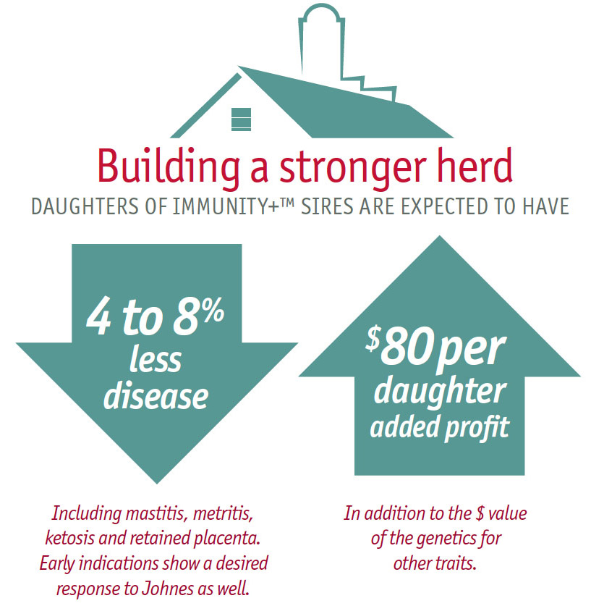
Notes:
Daughters of Immunity+ sires are expected to have 4 to 8% less incidence of disease including mastitis, metritis, retained placenta, Johne’s and most other infectious diseases.
This reduction may seem insignificant or small, however we must remember the graph shown earlier on disease incidence.

Slide 33

Future Research & Development
Validation of health results in daughters of Immunity+ bulls
Genomic studies for immune response
Notes:
The Immunity+ product line is market ready. It is the result of a significant amount of research and published papers in 91 different publications over the past 15 years. Yet it is still a new and developing technology. Semex will continue to invest significantly in research in this area to validate the immune response and health results in the daughters of Immunity+ bulls.
Also, an exciting area of development is the research towards a genomic test for high immune response.

Slide 34
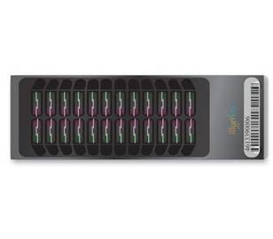
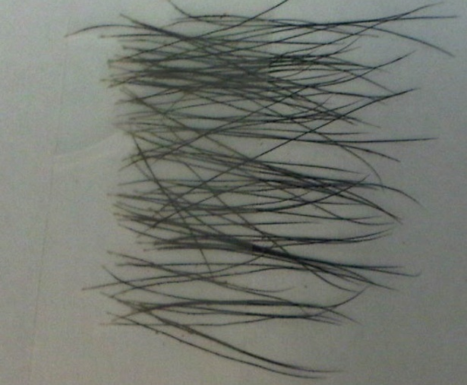
HIR Genome-Wide Association Study
Objective:
To determine genetic profiles associated with enhanced IR
Methods:
Selective genotyping of High and Low immune responders
using the Illumina Bovine SNP50
163 cows genotyped (81 HIR and 82 LIR)
Generalized quasi-likelihood score method
Minor allele frequency > 0.05
Minimum call rate > 0.85
Notes:
The University of Guelph conducted a genome wide association study for immune response. 163 animals were selected, 81 of which were categorized as high immune responders and 82 of which were categorized as low immune responders. As opposed to average immune response animals, it is important to select animals in the two extremes to help find the associated genes. These animals were submitted for a 50K SNP genomic test and an association study was conducted between the immune response measures that the 50k SNP markers.
Generalized quasi-likelihood score method
– accounts for genetic relationships among animals
- is not biased by selective genotyping because it is based on a logistic regression approach
Of interest, 2,580 SNPs were found to be significantly associated with Antibody-mediated immune response measures.
34

Slide 35
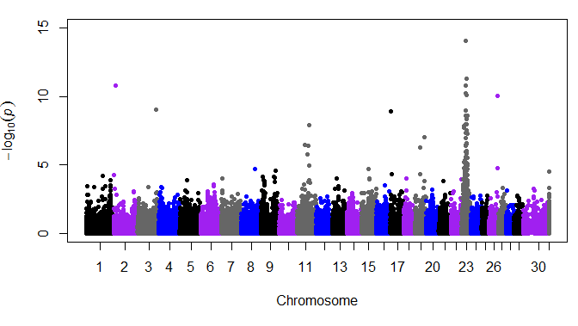
Genomic markers for AMIR
Notes:
This graph shows 50,000 dots representing the SNP markers across the 30 chromosomes. The height of each dot represents the importance of each SNP marker in relation to the measured Antibody-mediated immune response. We can observe a peak with a lot of dots lined up in chromosome 23.

Slide 36
Genomics of Immunity+
Chromosome 23 contains the Bovine Major Histocompatibility Complex (BoLA) which is responsible for acquired immunity in cattle
This confirms that HIR measurements are hitting the right target
More than 2,000 genes involved
Could lead to HIR genomics in future
Notes:
Interesting, chromosome 23 contains the Bovine Major Histocompatibility Complex (known as the BoLA) which has been generally recognized as being responsible for acquired immunity in cattle. In many ways, this is proof positive that the cell-mediated and antibody-mediated immune response measures applied under this technology are hitting the right target.
Selection for immunity is not a single gene. The immune response is directed by a complex network involving more than 2,000 genes. This research will continue to be a high priority for Semex with hopes to develop a accurate genomic test for Immunity+ in the not too distant future.

Slide 37
First Bulls Tested at Semex
No adverse reactions and no cross-reactivity were found
before and after HIR testing protocol
Notes:
Before outlining the Immunity+ bulls overall, we should first look at a sample of what the results look like after the bulls have been tested. This graph shows the first 15 bulls who were tested at Semex. The blue bars represent the antibody-mediated response measures and the black triangles represent the cell-mediated immune response measures (skin thickness).
Immunity+ sires are bulls with a balanced overall defense against both viral and bacterial infections. By looking at some actual bull results, we can see what it takes to be an Immunity+ sire. Bull 2 has a high cell-mediated response but a low antibody-mediated response, so he would not be Immunity+. Bulls 9 and 10 had a low response for both types of acquired immunity. Whereas bull 4 had a high immune response result for both types of acquired immunity. Bull 4 would be an eligible candidate to become an immunity+ sire.

Slide 38
Immune Response Distribution
Notes:
Again, bulls will vary in their immune response for the two types of acquired immunity from bulls that are low-low, low-average, average-low, high-average, average-high and high-high. It is the high-high bulls that are sought at Immunity+ bulls. Only 10% of tested bulls are designated as Immunity+.
An overall immune response value can be derived for each bull which combines their cell-mediated and antibody-mediated immune responses. We can take the overall immune response for all tested sires, and calculate the correlation between overall immune response and the traditional health traits for which we have sire proofs.

Slide 39
Immunity+ Bulls
(9 Proven + 32 Genomax)
Sire Proof | Average - Immunity+ Bulls | Advantage Over Tested Non-Immunity+ Bulls
TPI | 2106 | +80
Net Merit | $564 | +$91
Productive Life | 4.8 | +0.8
SCS | 2.76 | -0.06 (favourable)
DPR | +0.3 | +0.5
Daughter Calving Ease | 6.5 | -0.2 (favourable)
Notes:
In December 2012, there will be 9 Immunity+ Holstein proven bulls and 32 Immunity+ Holstein Genomax bulls. In the Jersey breed, there will be 1 Immunity+ proven bull and 5 Immunity+ Genomax bulls.
Of the Holstein bulls, we can compare the Semex Immunity+ bulls with the Semex bulls who were tested for immune response but not Immunity+ sires. Immunity+ sires had an advantage for total merit in terms of TPI and Net Merit, showing an 80 point and $91 advantage respectively. Immunity+ sires provide good productive life with an average proof of +4.8 which is very high and +0.8 higher than other tested bulls. The Immunity+ lineup has advantages across the health related traits including somatic cell score, fertility and daughter calving ease.

Slide 40

Released on December 4, 2012
Contact us at:
Immunity@semex.com
Notes:
Immunity+ sires is an innovative and exciting new technology that producers can start harvesting the benefits starting on December 4, 2012 with the next release of sire proofs. Large, health-conscious, commercial dairies who are early adaptors to new technologies are expected to be among the first to take advantage of Immunity+ sires offered by Semex.

Slide 41



